Slide 1

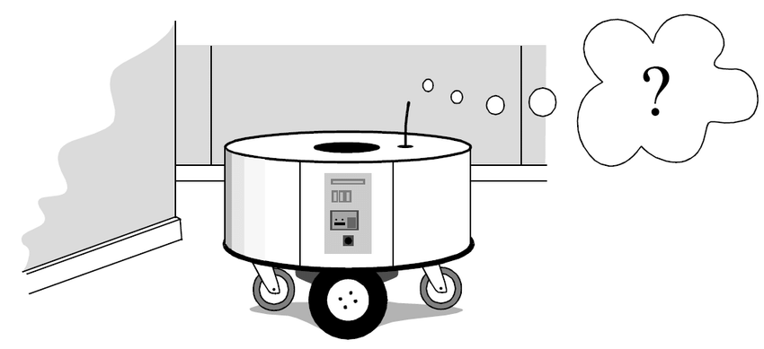
Monte Carlo Localization
Project by- Sarthak Mishra (18388) and Siddhant Sekhar (18395)

Slide 2
Contents
Monte Carlo Method
Robot Localization
Monte Carlo Localization
Results and Discussions
Limitations
Bibliography

Slide 3
1.
Monte Carlo Method
What did we learn in the course

Slide 4
Monte Carlo Methods
Monte Carlo methods, or Monte Carlo experiments, are a broad class of computational algorithms that rely on repeated random sampling to obtain numerical results.
use randomness to solve problems that might be deterministic in principle.
Can be used to solve any problem having a probabilistic interpretation.

Slide 5
2. Robot Localization
The problem

Slide 6
Robot Localization
Estimate the state of the robot at the current time-step k , given knowledge about the initial state and all measurements up to the current time.
Z^{k} = { z_{k}, i = 1 …. k }
Three-dimensional state vector: Position and Orientation of Robot
x = [ x, y, θ ]^{T}
Interested in constructing the posterior density p( x_{k} | Z^{k} ) of the current state conditioned on all measurements.
This PDF is taken to represent all the knowledge we possess about the state x_{k}, and from it we can estimate the current position.

Slide 7
Prediction Phase
to localize the robot we need to recursively compute the density p( x_{k} | Z^{k} ) at each time-step. This is done in two phases:
Prediction Phase and
Update Phase
We use a motion model to predict the current position of the robot in the form of a predictive PDF p(x_{k} | Z^{k}) , taking only motion into account.
We assume that the current state x_{k} is only dependent on the previous state x_{k-1} and that the motion model is specified as a conditional density p(x_{k} | x_{k-1}, u_{k-1}) where u_{k-1} is a control input.
Predictive density over x_k is obtained by integration:
p(x_{k} | Z^{k-1}) = ∫ p(x_{k} | x_{k-1} , u_{k-1}) * p( x_{k-1} | Z^{k-1} ) * dx_{k-1}

Slide 8

Update Phase
We use a measurement model to incorporate information from the sensors to obtain the posterior PDF p(x_{k} | Z^{k})
We assume that the measurement z_{k} is conditionally independent of earlier measurements Z^{k-1} given x_{k} , and that the measurement model is given in terms of a likelihood p( z_{k} | x_{k} ).
This term expresses the likelihood that the robot is at location x_{k} given that z_{k} was observed.
The posterior density over x_{k} is obtained using Bayes theorem:
After the update phase, the process is repeated recursively.

Slide 9
3. Monte Carlo Localization
The solution

Slide 10
Monte Carlo Localization
In sampling-based methods one represents the density p( x_{k} | Z^{k} ) by a set of N random samples or particles S_{k} = { s^{i}_{k} ; i = 1 … N } drawn from it.
The goal is then to recursively compute at each time step k the set of samples S_{k} that is drawn from p( x_{k} | Z^{k} ).
These class of algorithms known as Particle Filters or Monte Carlo Filter or Monte Carlo Localization. The algorithm proceeds as follows:
Prediction Phase:-
we start from the set of particles S_{k-1} computed in the previous iteration
apply the motion model to each particle s^{i}_{k-1} , by sampling from the density p( x_{k} | s^{i}_{k-1} , u_{k-1} ):

Slide 11
MCL (Prediction and Update Phase)
Monte Carlo Prediction Phase:
(I) for each particle s^{i}_{k-1}:
draw one sample s’^{i}_{k} from p( x_{k} | s^{i}_{k-1} , u_{k-1} )
The prime in s’^{i}_{k} indicates that we have not yet incorporated any sensor measurement at time k.
Update Phase:-
we take into account the measurement z_{k}
Weight each sample S’_{k} by the weight m^{i}_{k} = p( z_{k} | s’^{i}_{k} ), i.e. the likelihood of s’^{i}_{k} given z_{k}.
We then obtain S_{k} by resampling from this weighted set:
(II) for j = 1..N:
draw one S_{k} sample s^{j}_{k} from { s’^{i}_{k} , m^{i}_{k} }

Slide 12
MCL (Prediction and Update Phase)
The resampling selects higher probability samples s’^{i}_{k} that have a high likelihood associated with them.
In doing so a new set S_{k} is obtained that approximates a random sample from p( x_{k} | Z^{k} ).
After the update phase, the steps (I) and (II) are repeated recursively. To initialize the filter, we start at time k = 0 with a random sample S₀ = { s^{i}₀ }.

Slide 13
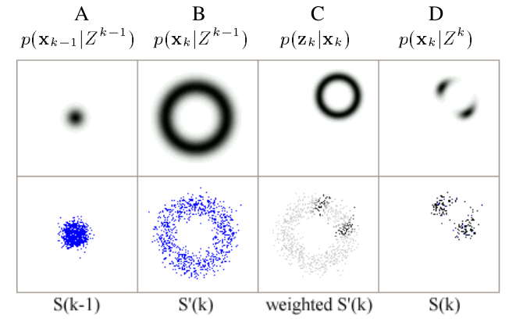
MCL - Graphical Interpretation
Fig. 1: The probability densities and particle sets for one iteration of the algorithm.

Slide 14
4. Results and Discussions
What we obtained after hours of tedious effort :P

Slide 15
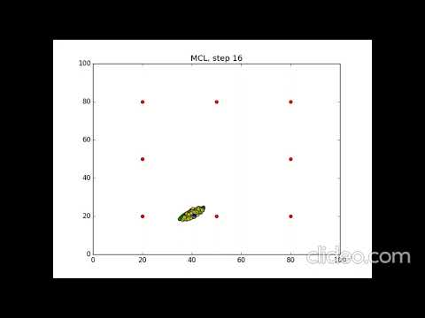
Result output from our code.

Slide 16
Limitations of MCL
works best for 10% to 20% perpetual noise
performs poorly when the noise level is too small
MCL with accurate sensors may perform worse than MCL with inaccurate sensor!!

Slide 17
Bibliography
Monte Carlo Localization for Mobile Robots
Monte Carlo Localization (Wiki)
Particle Filter (Wiki)
Particle Filter and Monte Carlo Localization (Lecture by Prof. Cyrill Stachniss)
Robust Monte Carlo Localization for Mobile Robots

